Slide 1









Welcome to Lodz University of Technology

Slide 2
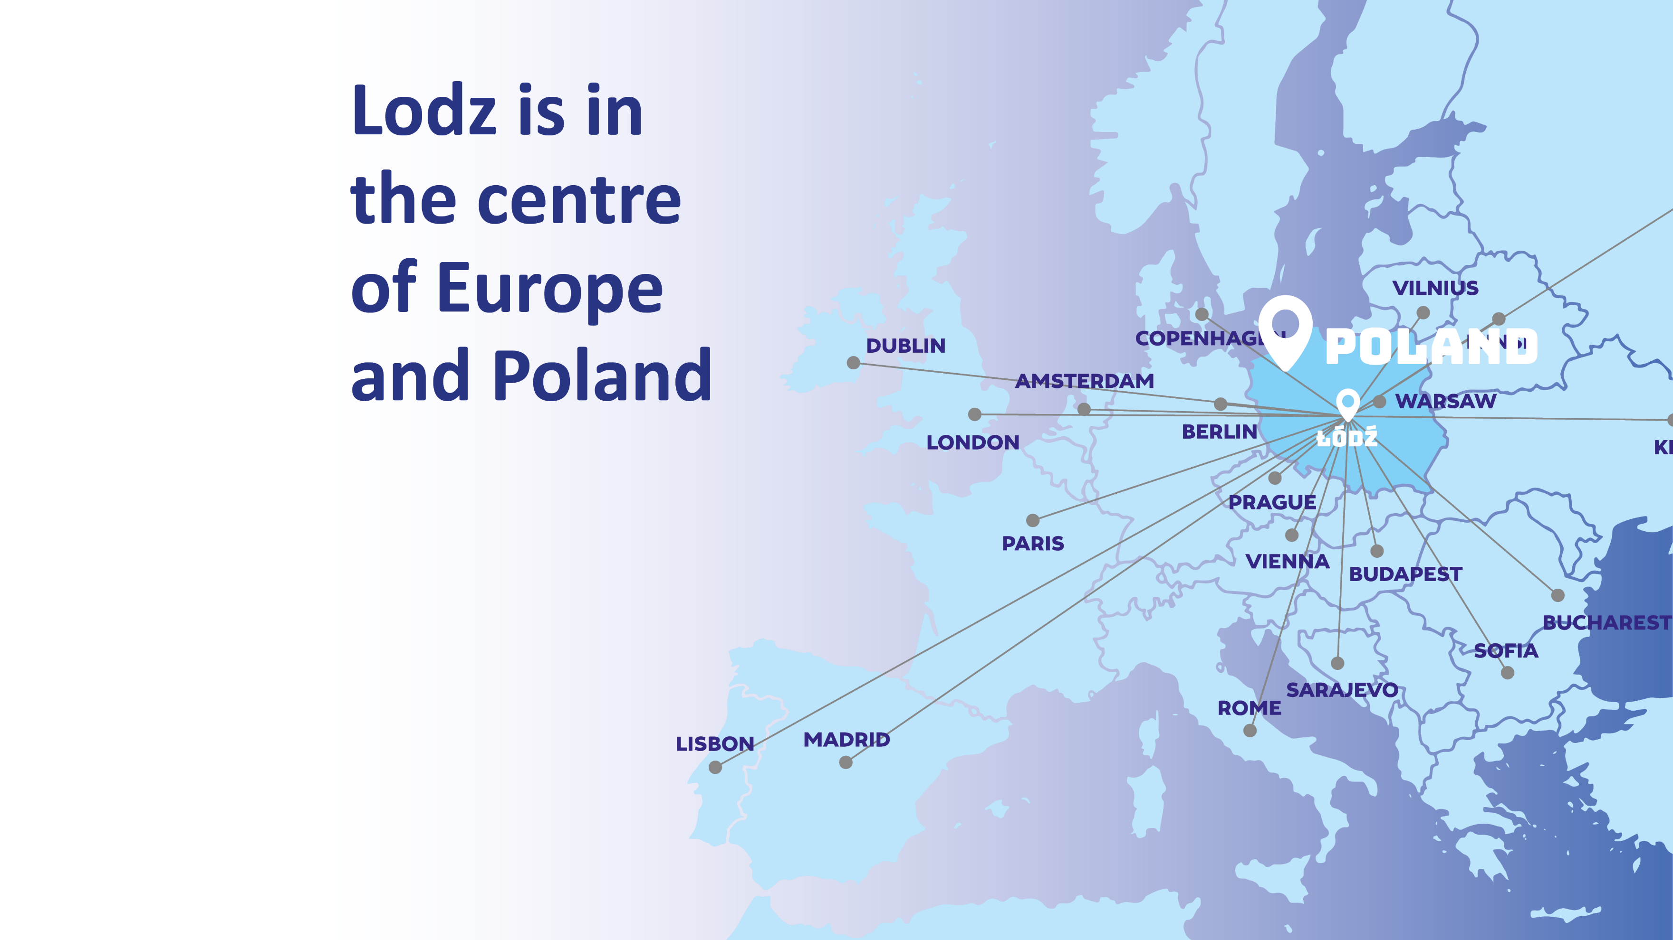

Slide 3

Lodz has
a postindustrial
history
Notes:
Łódź is a city with a unique historical and cultural heritage, constantly changing and developing

Slide 4
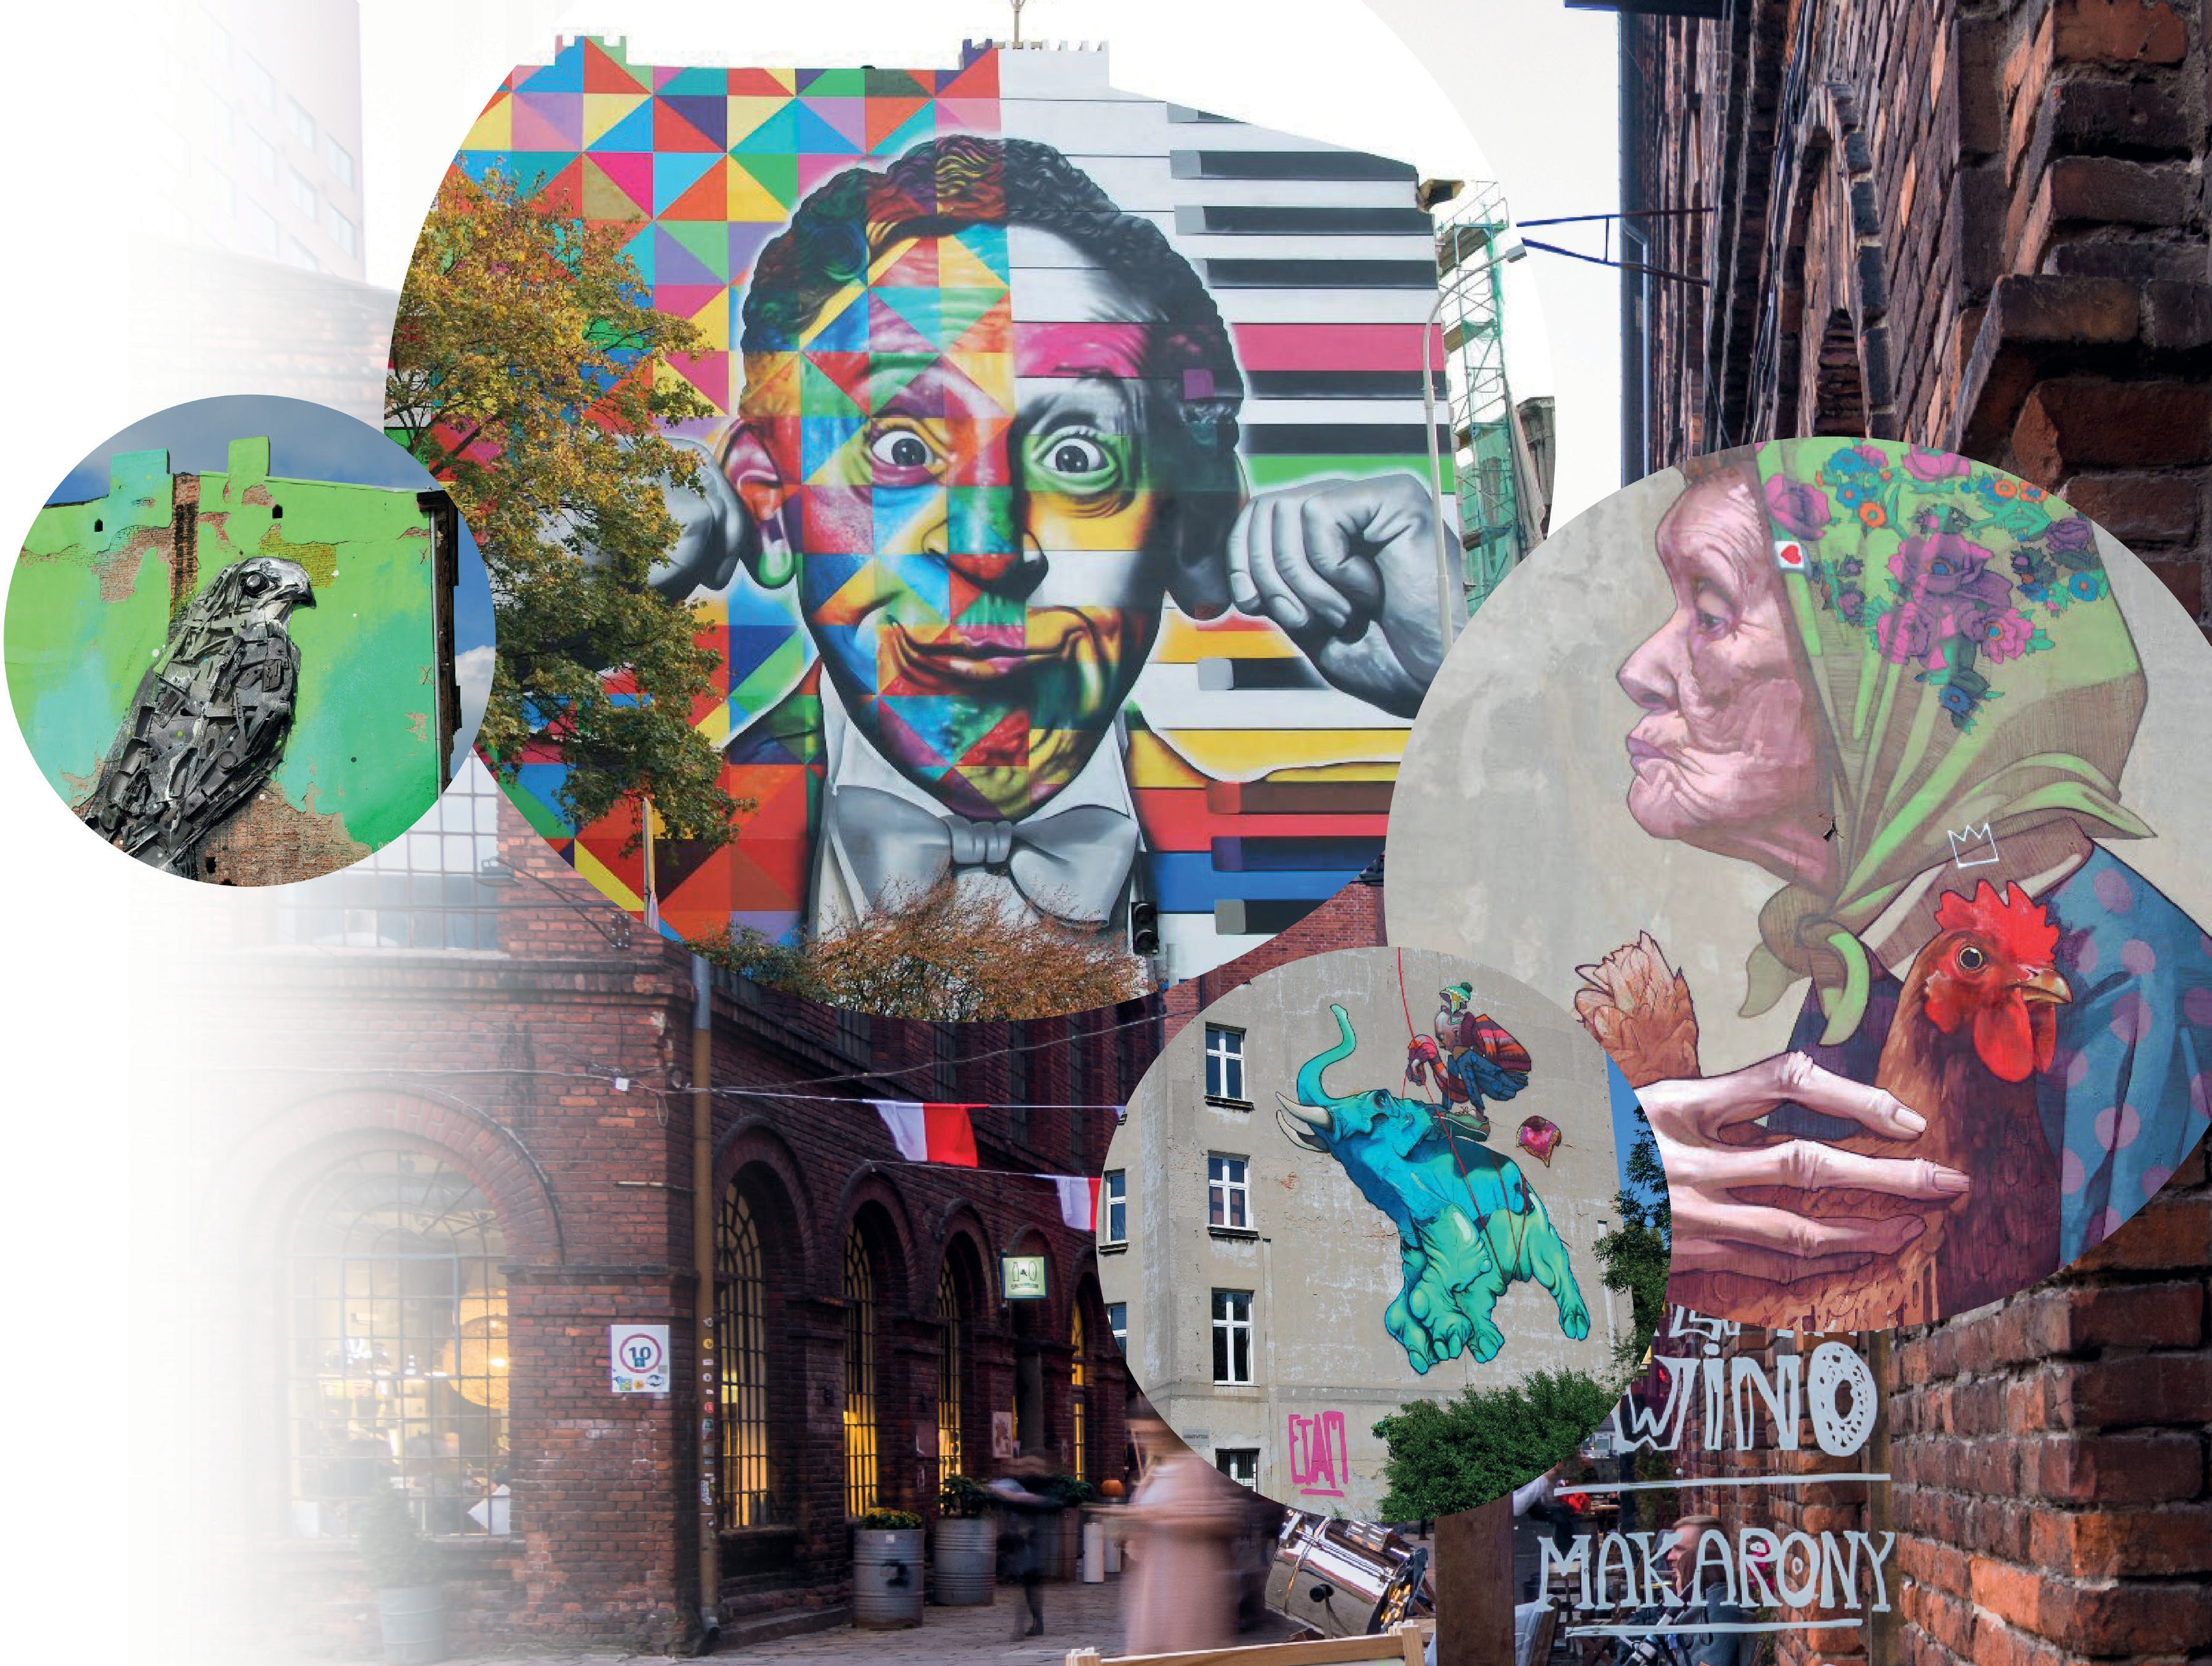
Lodz is a city of murals

Slide 5


Lodz is a city of students
Notes:
Łódź is an academic city, with 18 higher education institutions—6 public and 12 private—home to over 8 thousand foreign students. Let's go for a walk around the city...

Slide 6
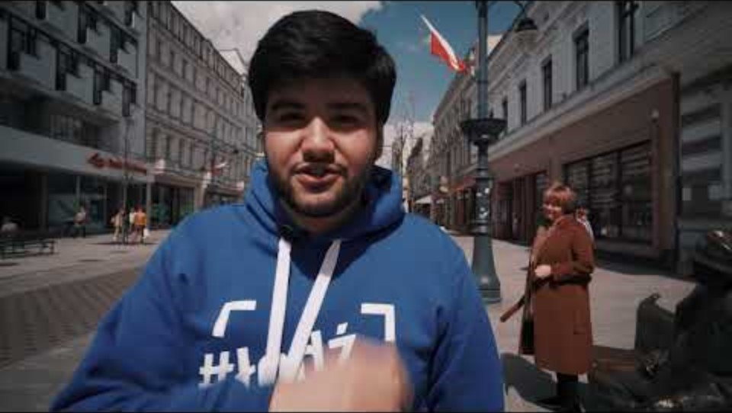

Slide 7




General information about
Lodz University of Technology

Slide 8






₇th
place in Poland among 50 academic
universities in the field of innovation*
₆th
place in Poland among 24
technical universities*
₉th
place in Poland among
50 academic universities*
* in the 2025 university ranking of the educational magazine „Perspektywy”

Slide 9




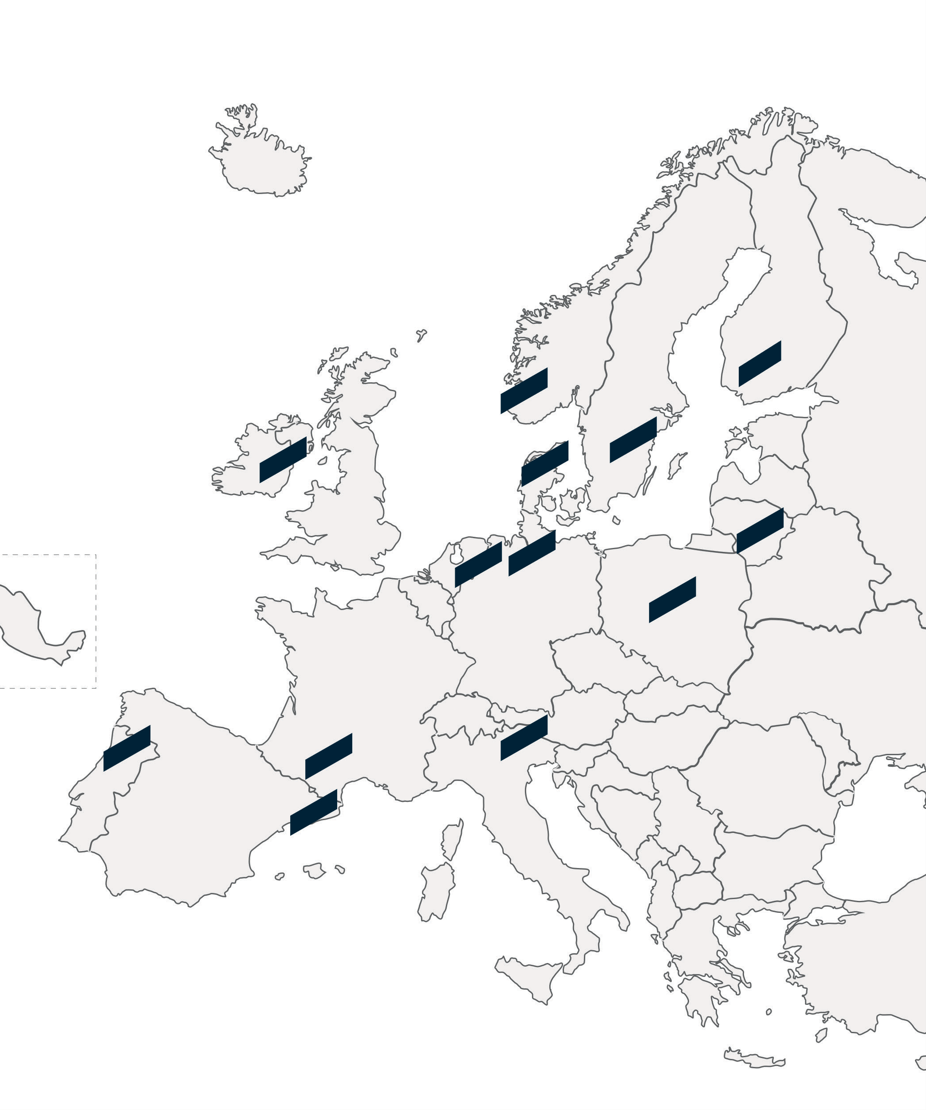











ECIU - European
Consortium of Innovative Universities
Notes:
Fourteen consortium members share a strong commitment to entrepreneurship, innovative forms of teaching and learning and high-quality research. Working together and learning from each other the ECIU universities strive for scientific and educational excellence which will have real impact on business and society. At the end of 2021, Lodz University of Technology has joined the elite ECIU network as the only university from Poland.

Slide 10








Active Educational Methods
TUTORING
PROBLEM BASED LEARNING (PBL)
FLIPPED EDUCATION
CASE STUDY
DESIGN THINKING (DT4U)
BLENDED LEARNING
CHALLENGE BASED LEARNING (CBL)
Notes:
Our innovative teaching methods allow us to make learning for students much more enjoyable. Replacing in some cases daunting lectures and replacing them with more active forms of project work.

Slide 11
Lodz University of Technology study offer

Slide 12




Faculties
Faculty of Electrical, Electronic, Computer and Control Engineering
Faculty of Mechanical Engineering
Faculty of Chemistry
Faculty of Civil Engineering, Architecture and Environmental Engineering
Faculty of Textiles and Design
Faculty of Biotechnology and Food Sciences
Faculty of Technical Physics, Information Technology and Applied Mathematics
Faculty of Organization
and Management
Faculty of Process and Environmental Engineering
International Faculty
of Engineering
Notes:
Lodz University of Technology has 10 faculties, and one of them – International Faculty of Engineering has programmes taught entirely in English and one in French.

Slide 13

International Faculty of Engineering (IFE)
IFE is an interfaculty unit that implements,
in cooperation with the faculties
of Lodz University of Technology,
study programmes in English/French.
It is the only unit of its kind among universities in Poland.
IFE in numbers:
approx. 400 admissions every year
over 1200 students, 12% of whom are foreign students
nearly 4500 graduates
foreign students from 39 countries
approximately 300 IFE students yearly on a one or two-semester exchange
nearly 600 lectures/tutorials conducted in foreign languages
approx. 250 universities in over 40 countries where IFE students can complete their Mobility Semester

Slide 14

All courses in English
BSc programmes
Advanced Biobased and Bioinspired Materials
Architecture
Biomedical Engineeringand Technologies
Business, Society and Technology Business Studies
Computer Science
Electronic and Telecommunication
Engineering
Industrial Biotechnology Information Technology Mathematical Methods
in Data Analysis
Mechanical Engineering Modelling and Data Science
Digital Management
MSc programmes
Applied Electronics Architecture Computer Science
and Information Technology
Design
Energy Systems in the Built Environment
Human-Computer Interaction
Industrial Biotechnology
Master in Mechanical Engineering Master of Business Studies
Smart Manufacturing and Management
Textile Engineering
Notes:
At Business, Society and Technology stdents can choose one of two traks: tolaty in English or mixed English-French

Slide 15





Additionals
European Project Semester
FinalProject
Textile/ Design Project
Research & Development Project Basic Polish
English in Action
Sports: volleyball, football,
basketball, judo
Students work in international and interdisciplinary teams of 3–6 students on their projects.
Projects are done in cooperation with commercial businesses and industries or with research centers.
Notes:
In addition to regular courses, students can work on group and individual projects. We also offer basic Polish language courses, and for those who want to improve their English, we have the 'English in Action' course. For those who lead an active lifestyle, our sports center offers many disciplines, such as volleyball, football, basketball, and judo.

Slide 16




Important
dates for exchange
1
Semesters
Winter semester: October - February Summer semester: March - July
Nomination deadlines Winter semester: July 15th Summer semester: November 15th
2
3
Application deadlines Winter semester: July 31st Summer semester: November 30th

Slide 17
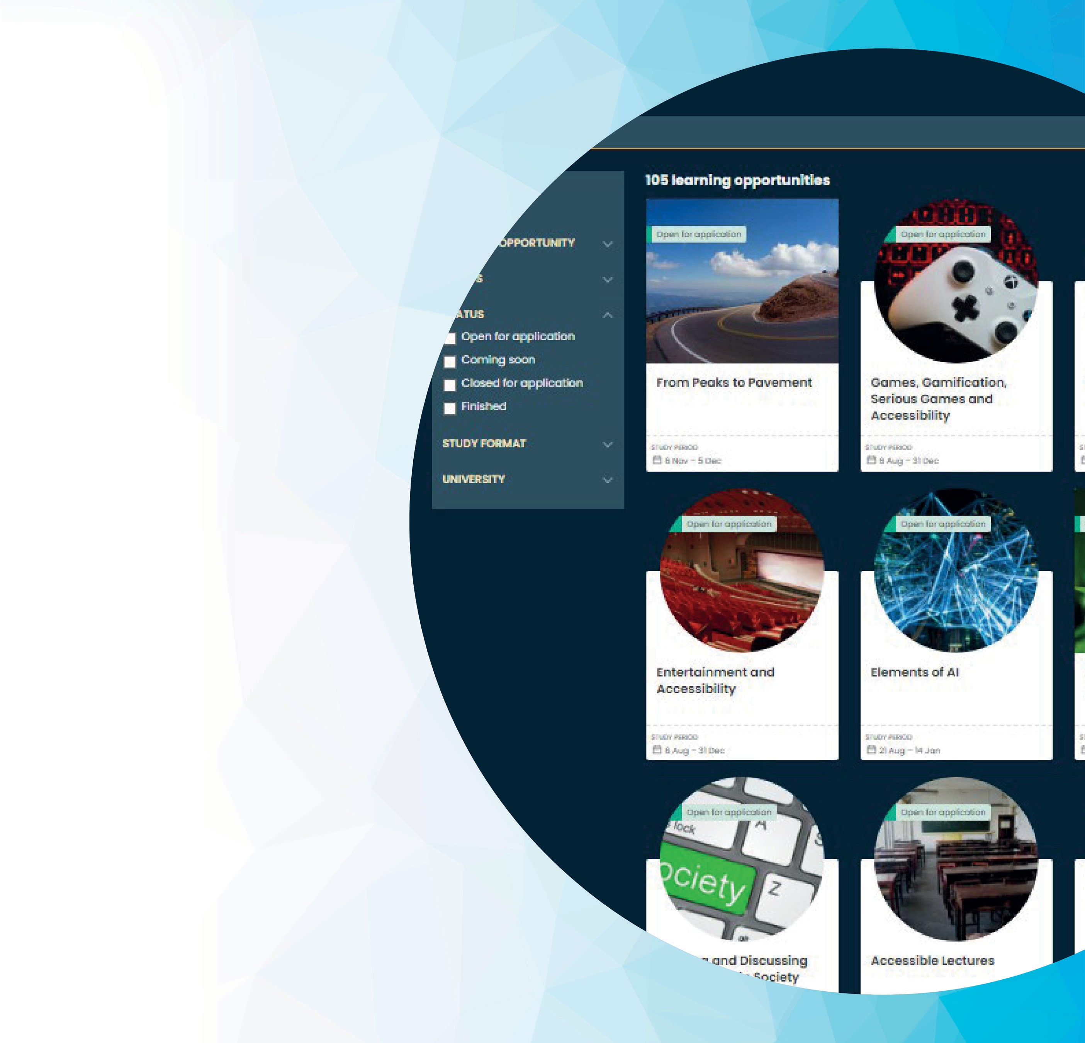
ECIU Learning
Opportunities
engage.eciu.eu
Challenges
Challenges are learning opportunities that engage diverse teams to solve real-life problems using a novel and practical method of challenge-based learning (CBL).
Micro-modules
Micro-modules are short learning opportunities that support learners to fill their knowledge gaps and boost their capabilities to successfully engage in ECIU University challenges. Learners can take micro-modules together with challenges or create their own learning path.
Notes:
ECIU Learning Opportunities are avalable for all students of the Technical University of Lodz inluded students from all exchange programmes.

Slide 18
Lodz University of Technology campus facilities

Slide 19








Facilities for students
LANGUAGE CENTRE
ACADEMIC HELP CENTRE
SPORTS CENTRE
LIBRARY
TUL DORMITORIES - PLACES FOR
ALL STUDENTS GUARANTEED

Slide 20
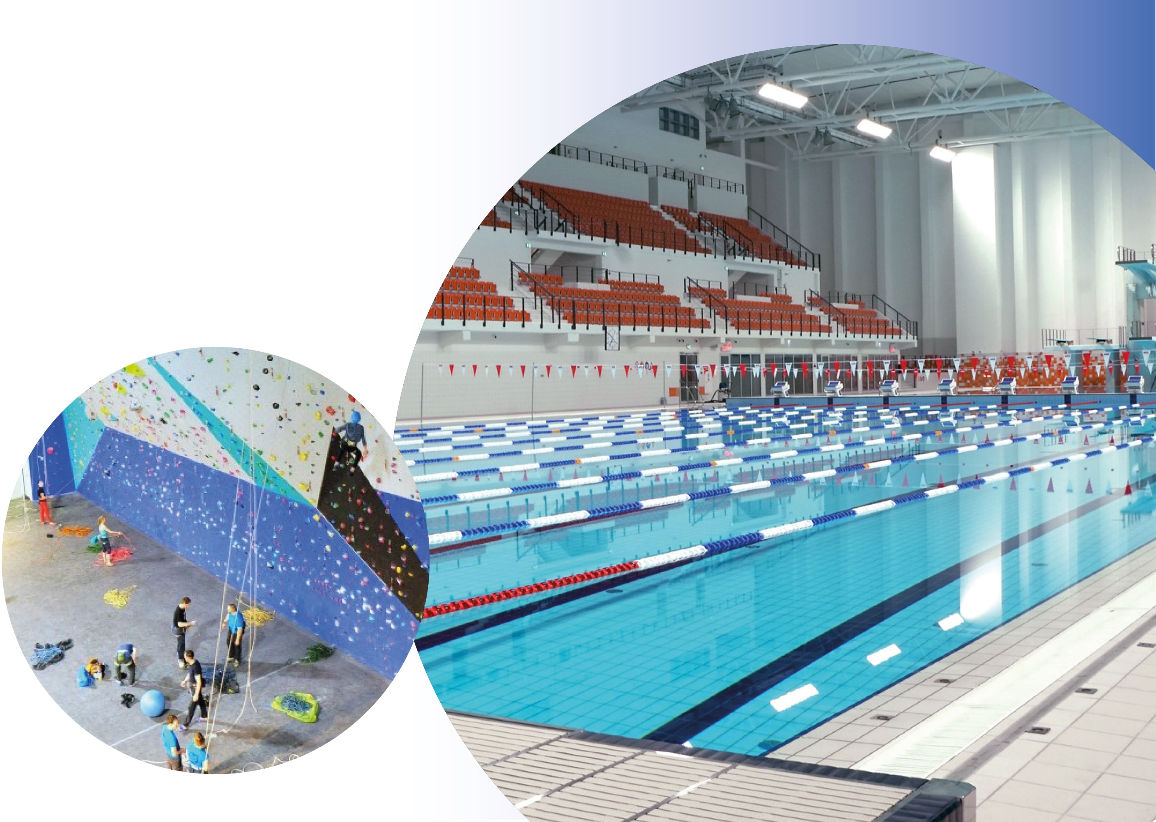





TUL Sport’s Bay

Slide 21
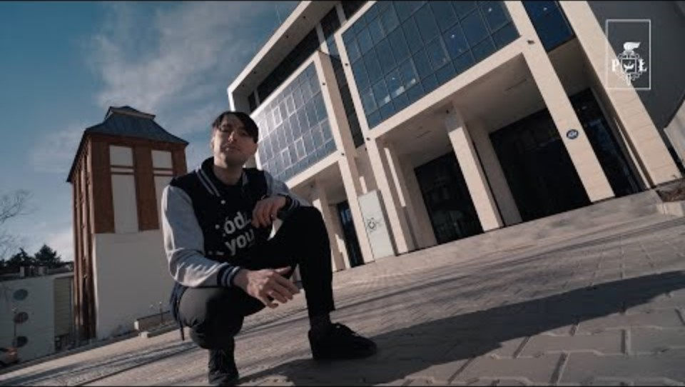

Slide 22






Student Assistance
Office
sao@info.p.lodz.pl
+48 42 638 38 44
p.lodz.pl/en
LodzUniversityofTechnology
politechnika_lodzka
Welcome Point
welcomepoint@info.p.lodz.pl
+48 42 638 38 57
https://cwm.p.lodz.pl/en/welcome-point

